Slide 1


Finding Home: An Analysis of Sydney's Rental Market
Providing recommendations for UNSW Students
Presented By
Hima Rohini Mallina

Slide 2
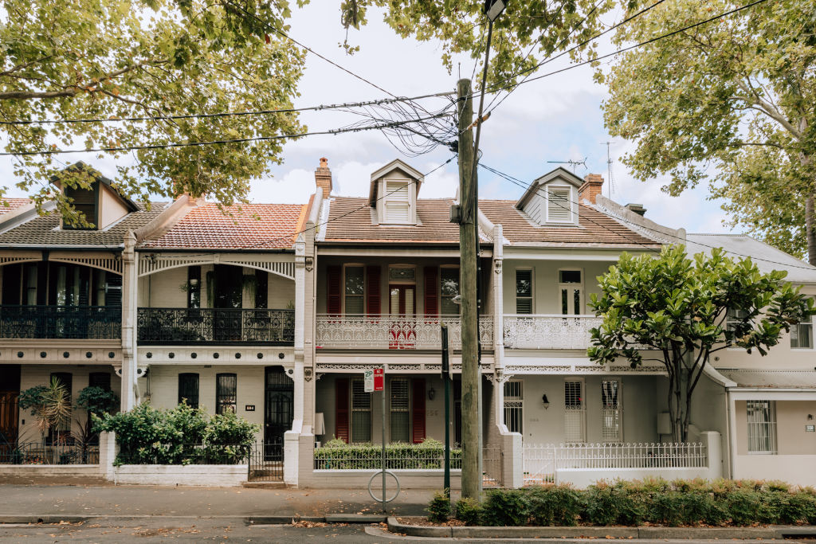
Agenda
Background and Objectives
Methodology
Main variable overview
Data Analysis
Recommendations
Conclusion

Slide 3
Executive Summary
Business Problem | High rental prices in Sydney are creating housing affordability issues for international students at University of New South Wales (UNSW), making it difficult to find the right location based on their budget, needs, and preferences.
Objective | To identify and recommend the best housing options for UNSW international students, factoring in affordability, location, and accessibility to essential services.
Data Sources | Rental Price - NSW government website Transportation Costs - Opal website from NSW government Distance from University - Australian Bureau of Statistics (ABS) Accessibility to Supermarkets - Area Search
Methodology and Tools | Data scrapping, statistical analysis, and data visualization with Python (Pandas, NumPy, Matplotlib, Seaborn)
Conclusion | Provide practical recommendations among popular areas for UNSW students to assist them in finding suitable rental options based on their preferred criteria.

Slide 4
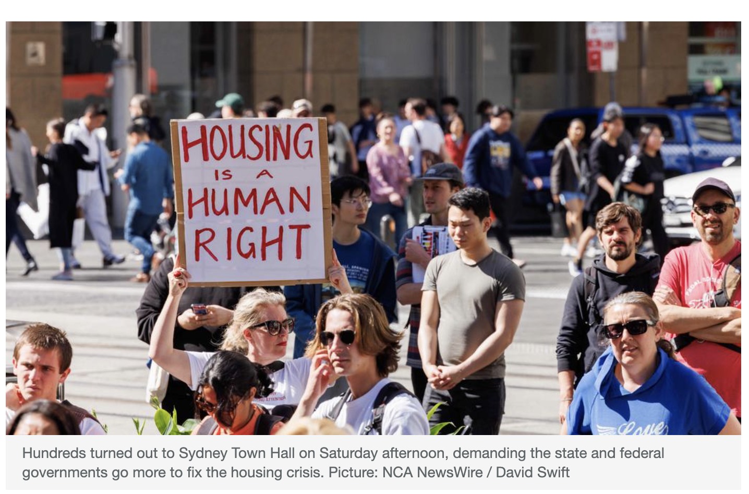
Background
Rental Crisis
House price affordability has declined faster in Australia than in most other OECD countries​ (Housing Sector Country Snapshot: AUSTRALIA, 2021)​
Students often find themselves in challenging situations while searching for rental accommodations that are budget friendly and well-located relative to their educational institutions and get access to essential services
Source: https://www.news.com.au/national/nsw-act/politics/hundreds-rally-calling-on-nsw-government-to-fight-housing-crisis

Slide 5




To give recommendations to UNSW students about rental options based on their budget and preferences: consider several factors including location, price stability, access to store, and overall considerations.
Objectives
Transportation costs & Proximity
Location with convenient, cost-effective, reasonable commuting time to travel to/from UNSW.
Affordability
Locations that offer affordability for students with limited budget, potentially with stable price.
The availability supermarkets and grocery stores
LGAs with enough supermarkets to meet the daily needs of international students.
Easier Availability
Consider types of rent that is easier to find.

Slide 6




Methodology
Data Acquisition
Data Assumption
Data Limitation
Tools Used
Opal card transportation costs: Transport for NSW Open Data
Sydney public transport fares: Opal website
LGAs and distance details: Matthew Proctor's website
Sydney supermarket density: AreaSearch
Main rental price data is from the third quarter of 2023.
Rent price is per room
All the student take public transportation.
Weekly transport, assumed 3 days go to the campus.
Budget <500 per week.
There might be fluctuations in rental price.
We don’t consider those who go to campus on walk or using private transportation.
Only include 10 LGAs: recommendations from UNSW website and add Paramatta, Strathfield, and Burwood as it is popular among UNSW students.
Data scrapping with Python
Excel to combine
Data visualization with Python (Pandas, NumPy, Matplotlib, Seaborn)

Slide 7
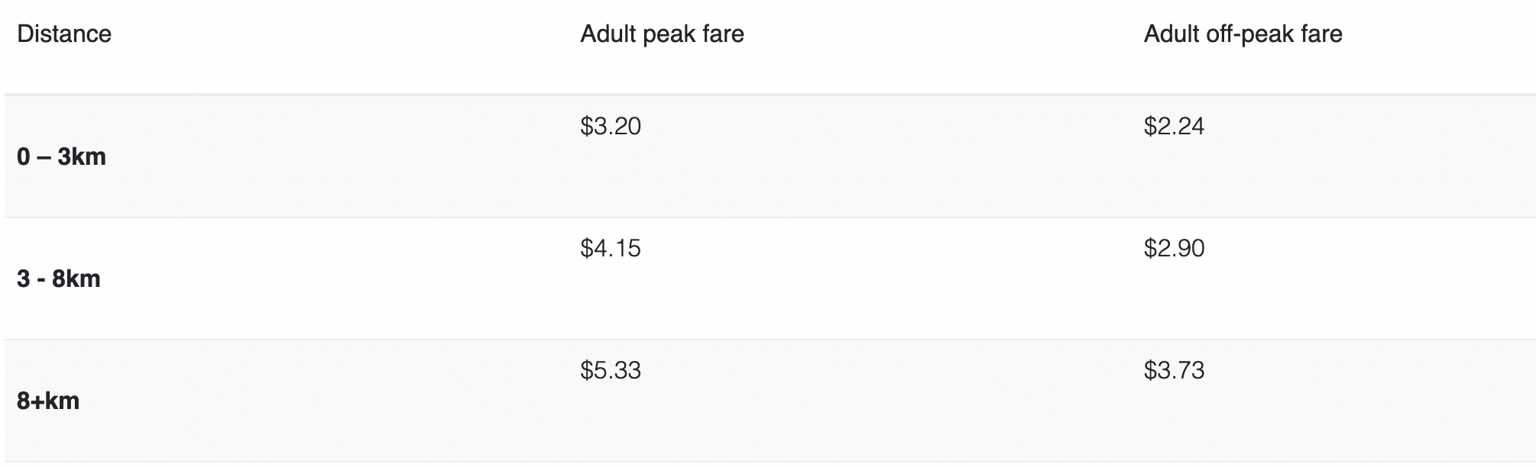
Transport Cost provided from Opal Website

Slide 8
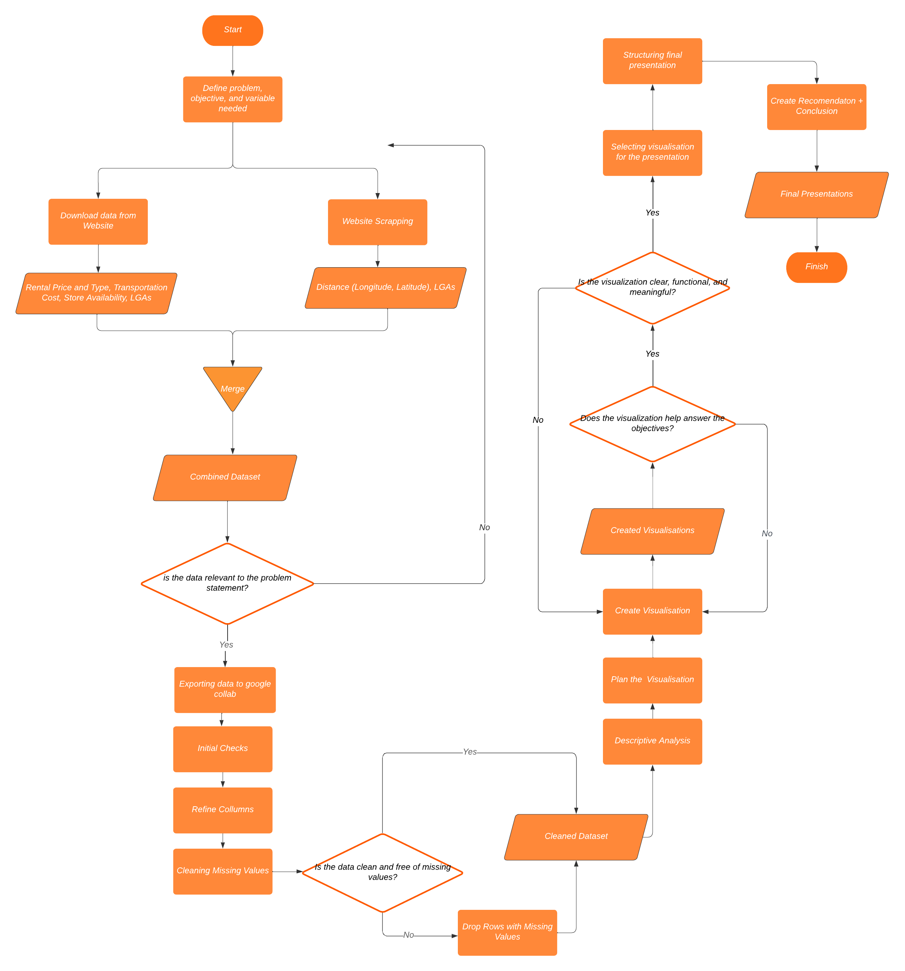
Flow Chart
Iterations:
Cleaning missing values and row with missing values
Visualisation that provide clear insight and meaningful recommendations

Slide 9

GROUP 1
Data Analysis

Slide 10
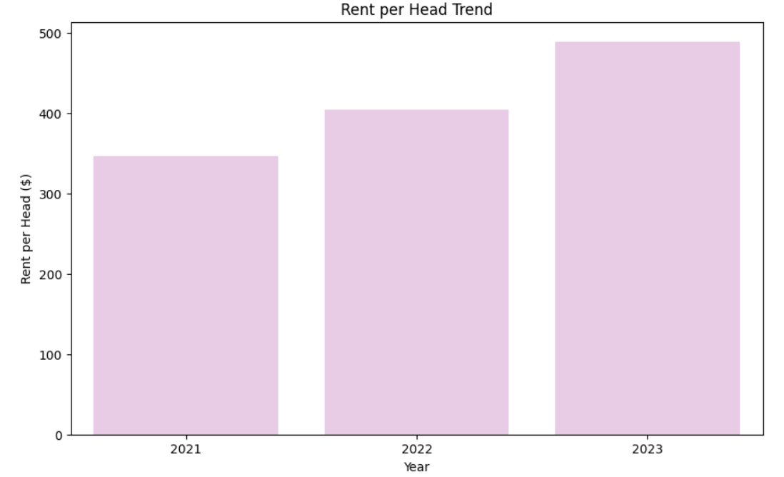
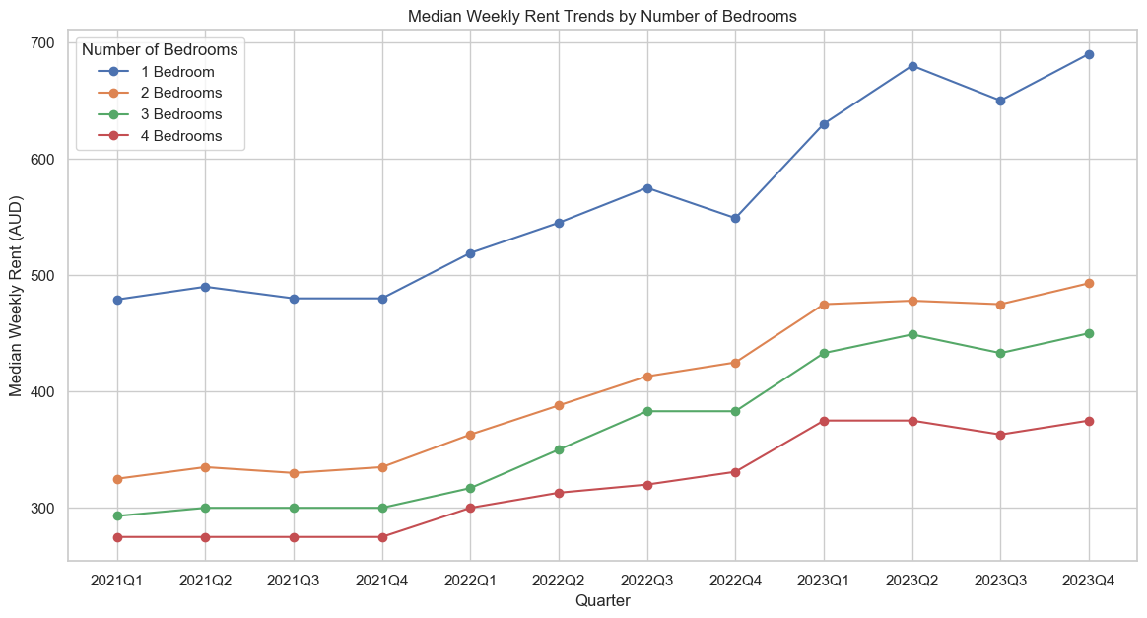
Rent Price Trend
Increasing trend of rent from the year 2021 to 2023
The weekly price rent has been increasing, happen across types but especially in dwellings with one bedroom. Meanwhile, the rest of the dwellings have had less aggressive increases.
Average Weekly Rent Price per Year
Weekly Price Trend by type of Dwelling

Slide 11
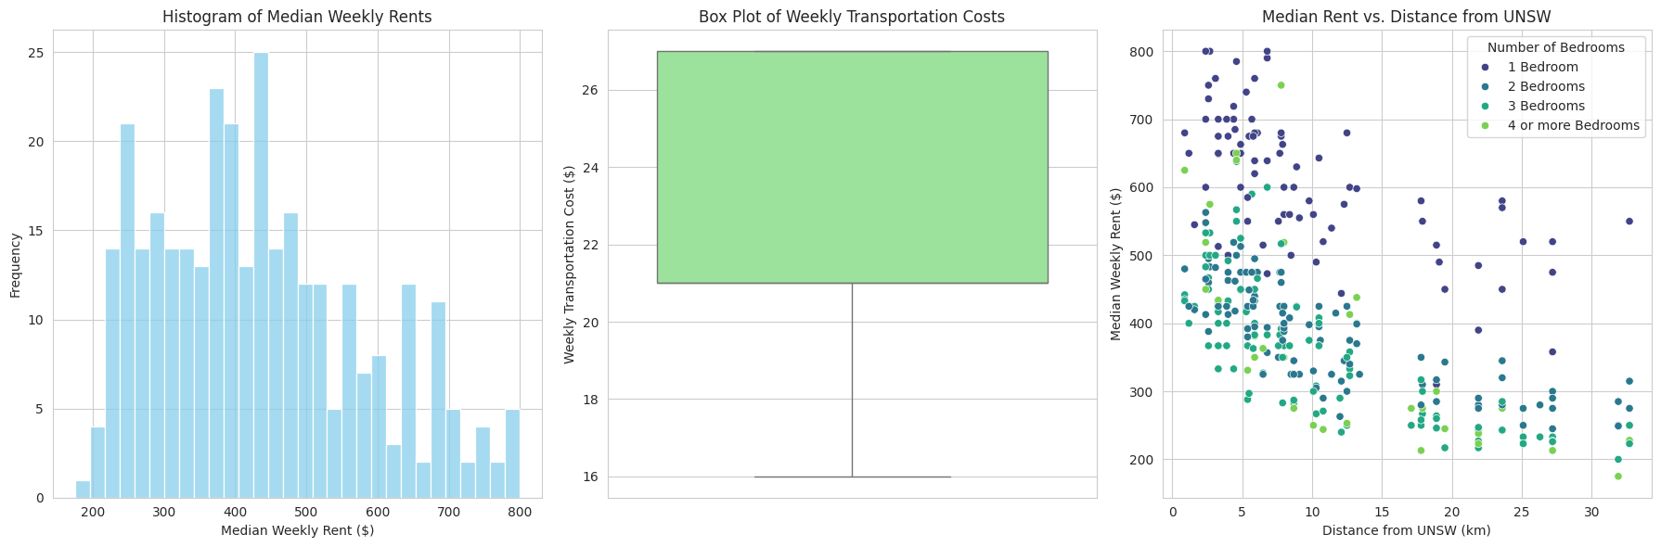
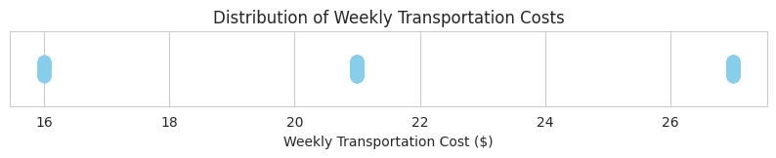
Data Description of Main Variable Consideration
Distribution of Rents
Transportation Cost
Impact of Distance on Rent
Rental prices ranging from $200 to $800, with a dense cluster around $450, indicating a mix of high-end and affordable options near UNSW.
No significant variation on the transportation cost, suggests that rent and other factors should be the primary factors in housing decisions, rather than transportation costs. The limitation in range is based on opal website.
Properties closer to UNSW generally have higher rents, especially within a 5 km radius. Those more than 10 km away offer lower rents and greater variability, suggesting that living further from campus can be cost-effective.

Slide 12
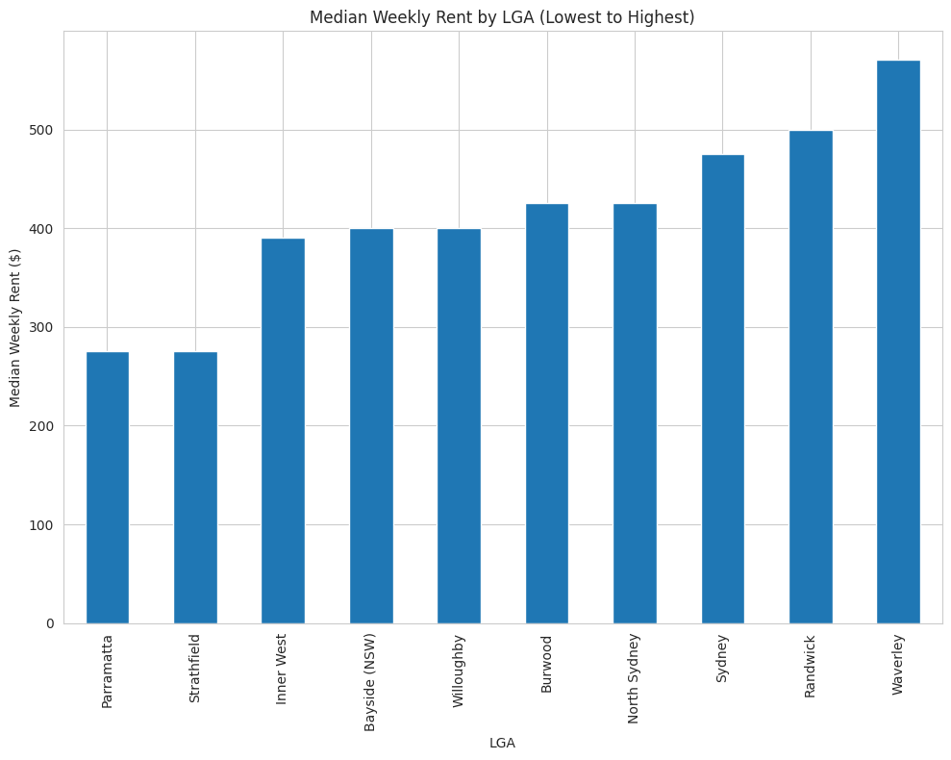
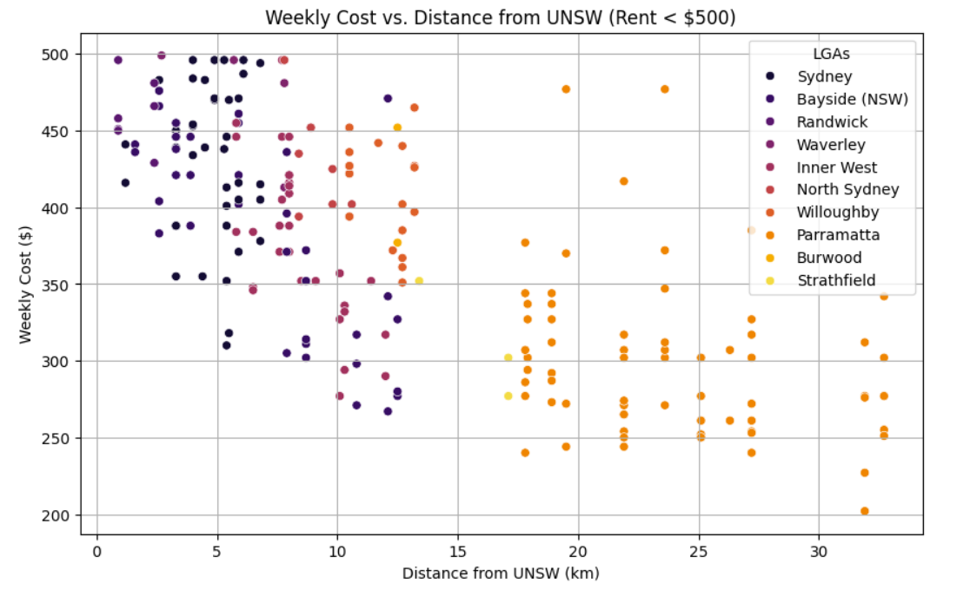
Affordability
Which LGAs to pick if affordability is the priority?
Parramatta and Strathfield have the cheapest weekly rent so recommended for those who have limited budget and can compromise on other variables. Paramatta has more options hence may be easier to find the rent, while Strathfield is closer to UNSW.
Weekly Rent Price (AUD) by LGAs
Distance vs Weekly Cost

Slide 13
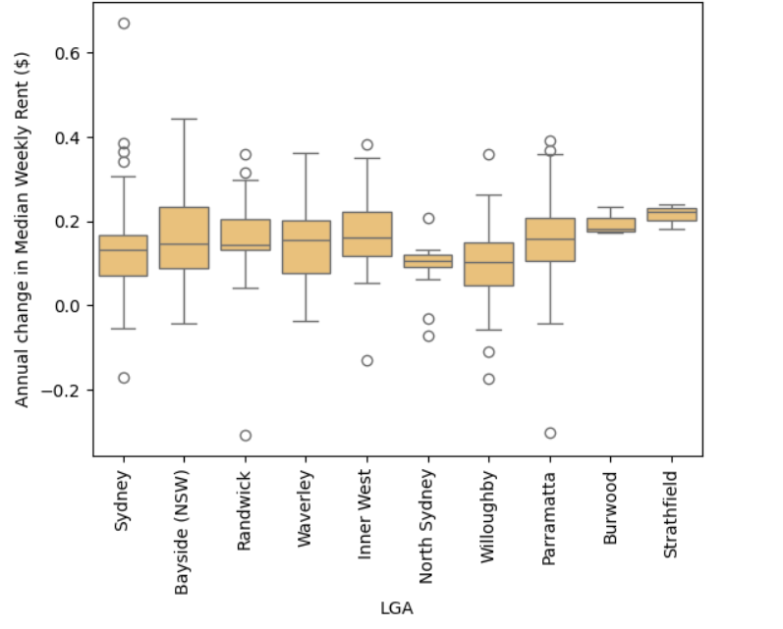
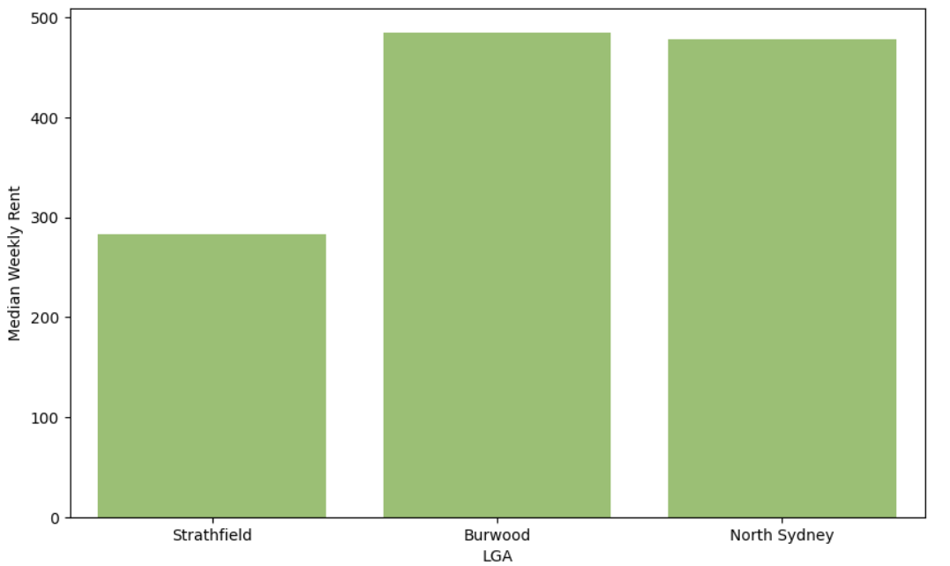
Which LGAs has most stable rental price?
Stability
LGAs with the most stable prices are Strathfield, Burwood, and North Sydney, with Strathfield having the lowest prices. Consider choosing these locations to worry less about rental price fluctuations.
Annual Change in Weekly Rent
Median Weekly Rent of 3 Most Stable LGAs

Slide 14
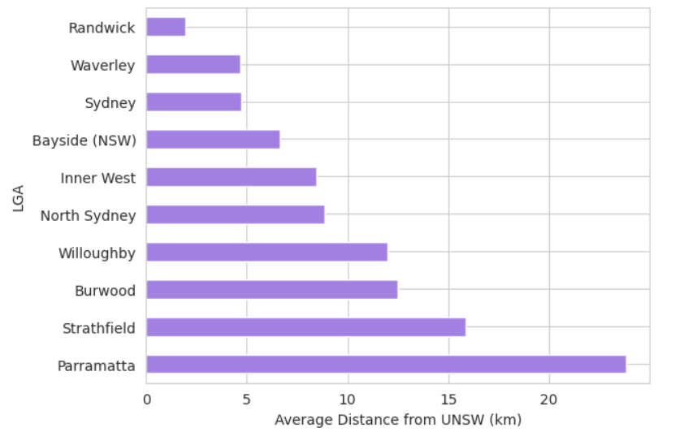
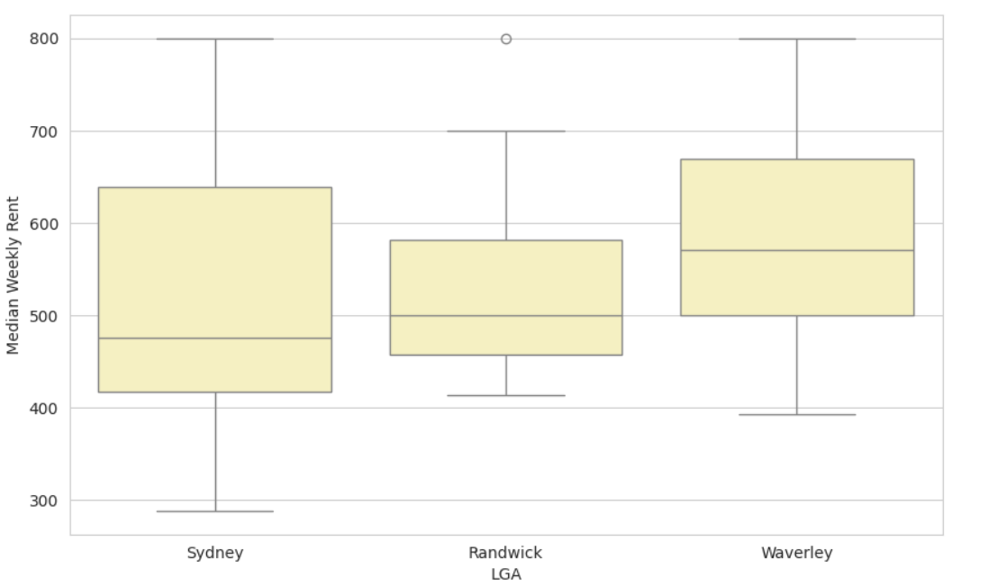
Proximity
Which LGAs to choose if proximity is the priority?
Randwick is the nearest LGA from UNSW, followed by Waverley and Sydney. Though Sydney has the lowest median weekly rent, it has a large range of price. So, Randwick is a suitable LGA with an acceptable median weekly rant and a small scale of rental price.
Average distance from UNSW by LGAs
Weekly Rent of 3 Nearest LGAs

Slide 15
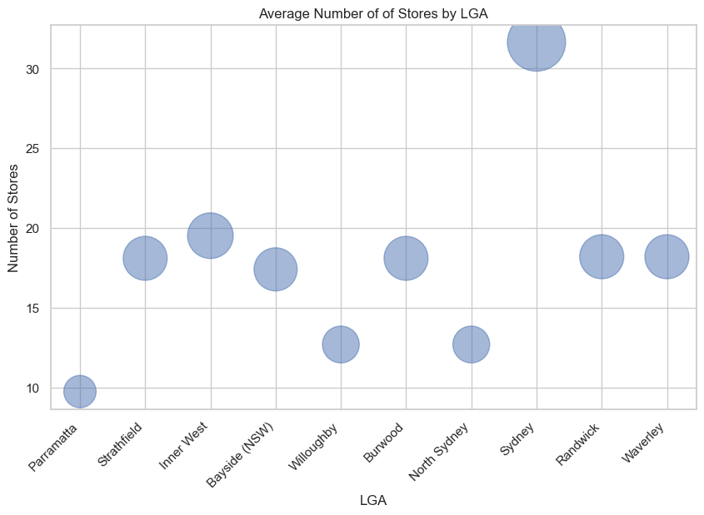
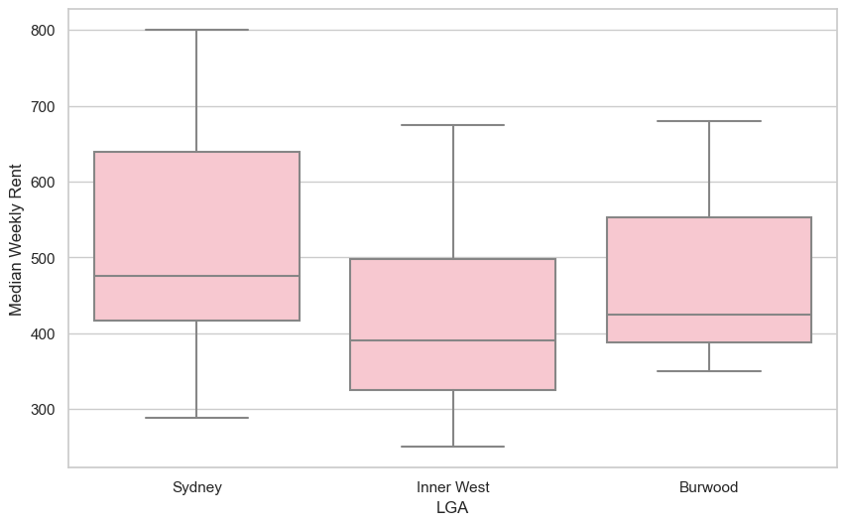
Store Availability
Which LGAs to choose if store availability is the priority?
Sydney has the most stores available, making access to amenities easier, followed by Inner West and Burwood. Considering the prices, Inner West may be the best option as it is more affordable.
Average Number of Stores by LGA
Weekly Rent of 3 LGAs with the Highest Number of Stores

Slide 16
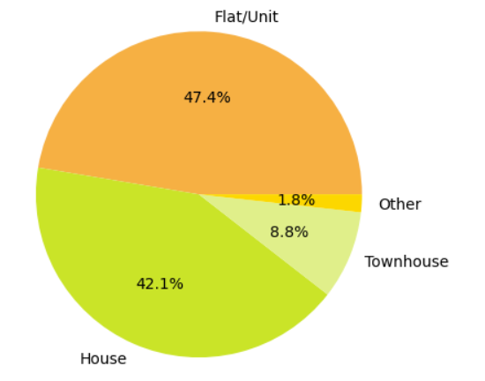
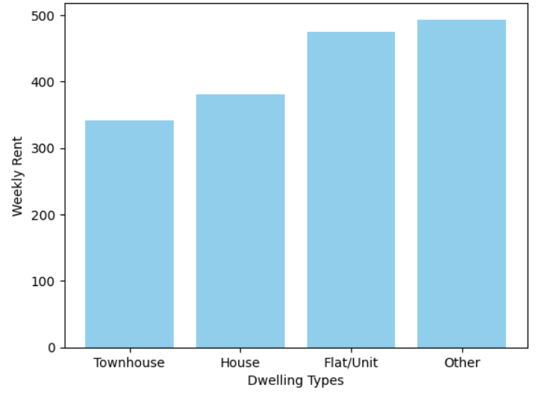
Dwelling Type
Which dwelling type to choose based on number and weekly rent?
Flat/Unit and House are two common dwelling types, while Townhouse and House have the lowest average rental price. Considering both number of housing types and average rent, House may be a reliable choice.
Dwelling Types with Weekly Rent < $500
Average rent of each dwelling type

Slide 17
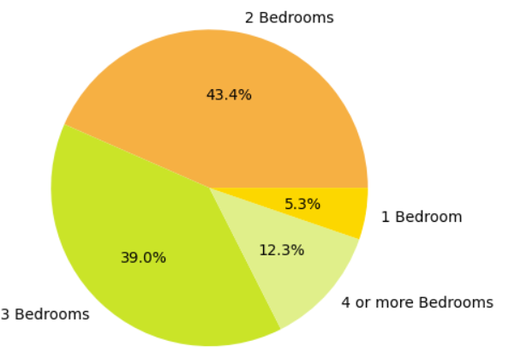
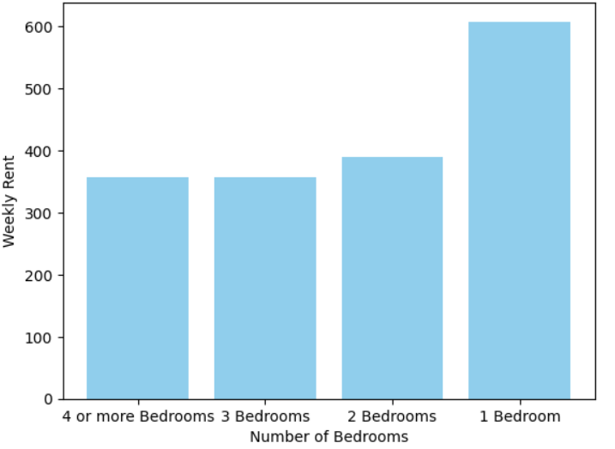
Number of rooms
What number of rooms to choose based on number and weekly rent?
2 and 3 bedrooms are two common types under the budget of $500, but 3 bedrooms has a slightly lower average rent than 2 bedrooms. So, 3 bedrooms could be a better choice for cost-saving purpose.
Number of bedrooms with Weekly Rent< $500
Average rent for different number of bedrooms

Slide 18
RECOMMENDATIONS BASED ON EACH PRIORITY
Recommendations Based on Priority
Options | Affordability | Proximity | Store Availability | Price Stability
1. | Parramatta | Randwick | Sydney | Strathfield
2. | Strathfield | Waverley | Inner West | Burwood
3 | Inner West | Sydney | Burwood | North Sydney
Data scrapping with Python
Easier to find and affordable:
Types of housing?
Number of bedroom?
House
3 bedrooms

Slide 19
Budget
How much budget is needed if students have different priorities and bedroom preferences?
Studios and areas with closer proximity to stores are more expensive. However, we can determine the budget based on the available options to choose from.
Average Weekly Rent ($)
Focus | Affordability | Proximity | Store Access
Best Location → | Paramatta | Randwick | Sydney
1 bedroom | 310 | 680 | 750
2 bedrooms | 245 | 435 | 495
3 bedrooms | 200 | 433 | 467
>=4 bedrooms | 175 | 625* | 331
*the data is limited
*>= 4 bedroom are assumed as 4 bedrooms

Slide 20
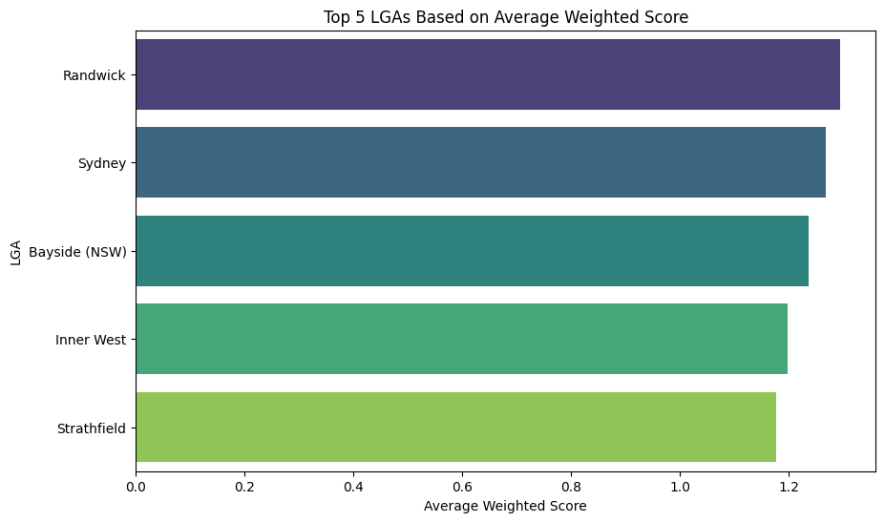
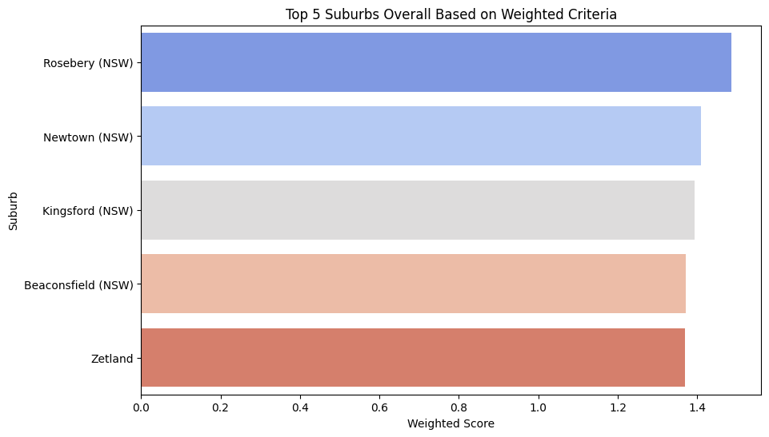
Overall Considerations
What if all variables are important?
Scoring Assumptions Rank:
Lower Rent price (-1.0): Strongly preferred.
Closer UNSW distance (-0.5): More desirable.
Lower transport cost (-0.3): Moderately important.
More stores (+0.2): Slight positive impact.
Recommendation Area Based on All Variables Consideration
Since all factors may be important for some students, here area that best considering rent price, proximity, transport cost, and store access with weighted assumptions.
Top 5 LGAs
Top 5 Suburbs
Steps: Define Weight, Normalize Data, Calculate weighted score, Calculate Overall Weighted Score, Group by Suburb and Plot Results

Slide 21
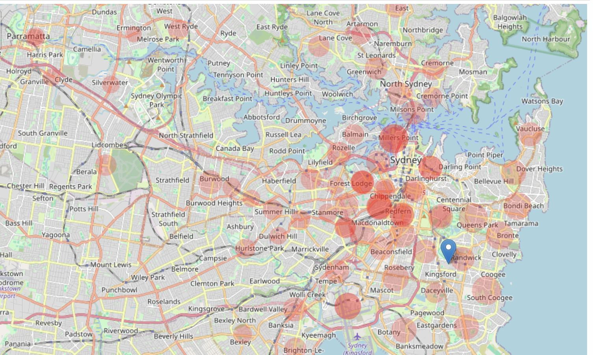
Map Of Rent Location By Price And Distance
Distribution of rent prices by distance in a map (Size of the bubble represents the price)

Slide 22
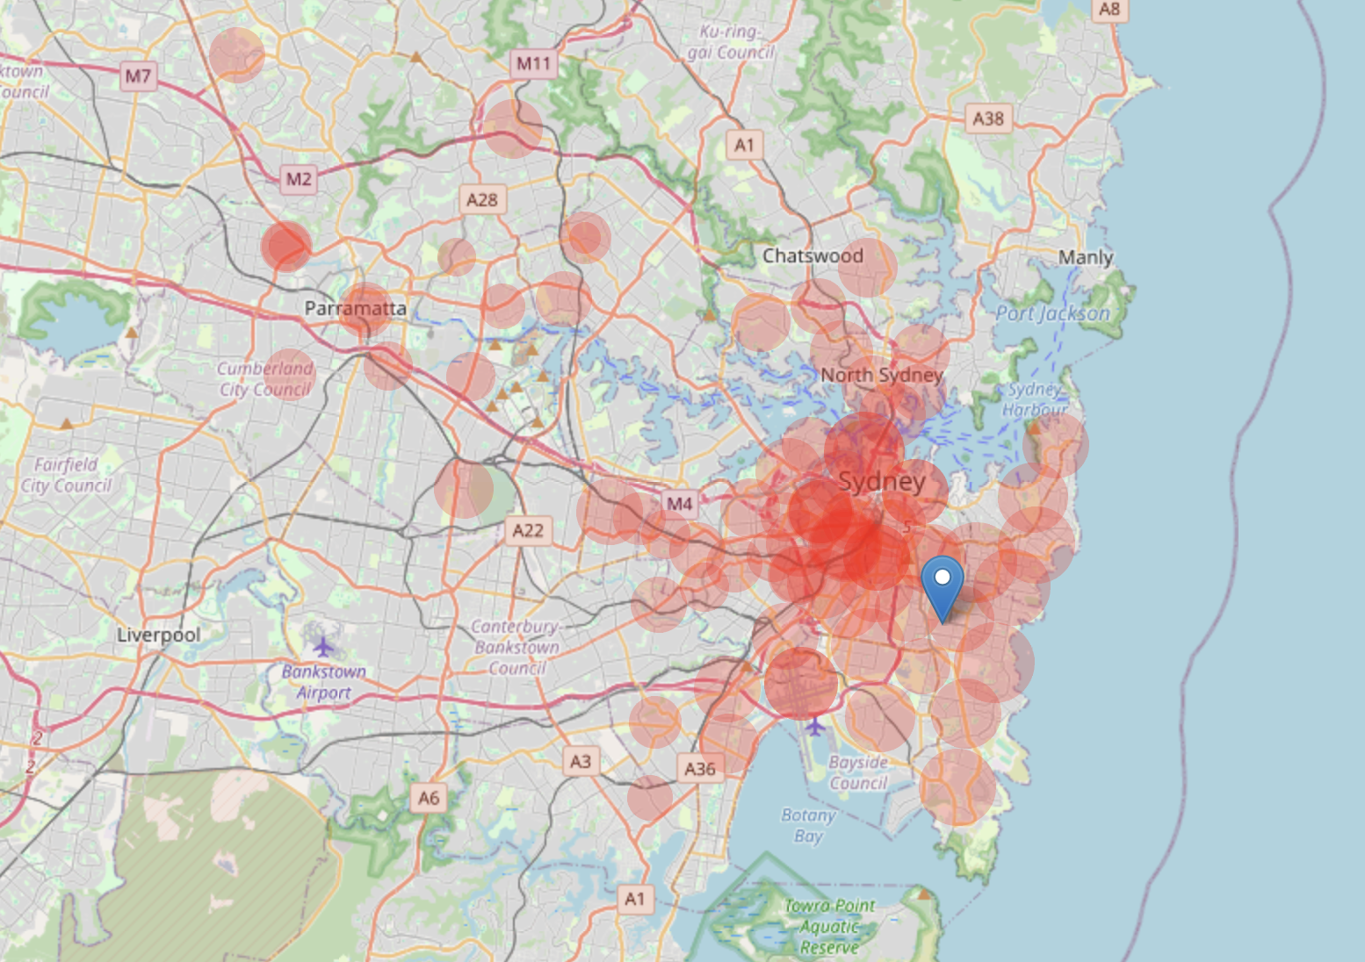
Map Of Rent Location By Price And Distance for 1 Bedroom
Distribution of rent prices by distance in a map (Size of the bubble represents the price)

Slide 23
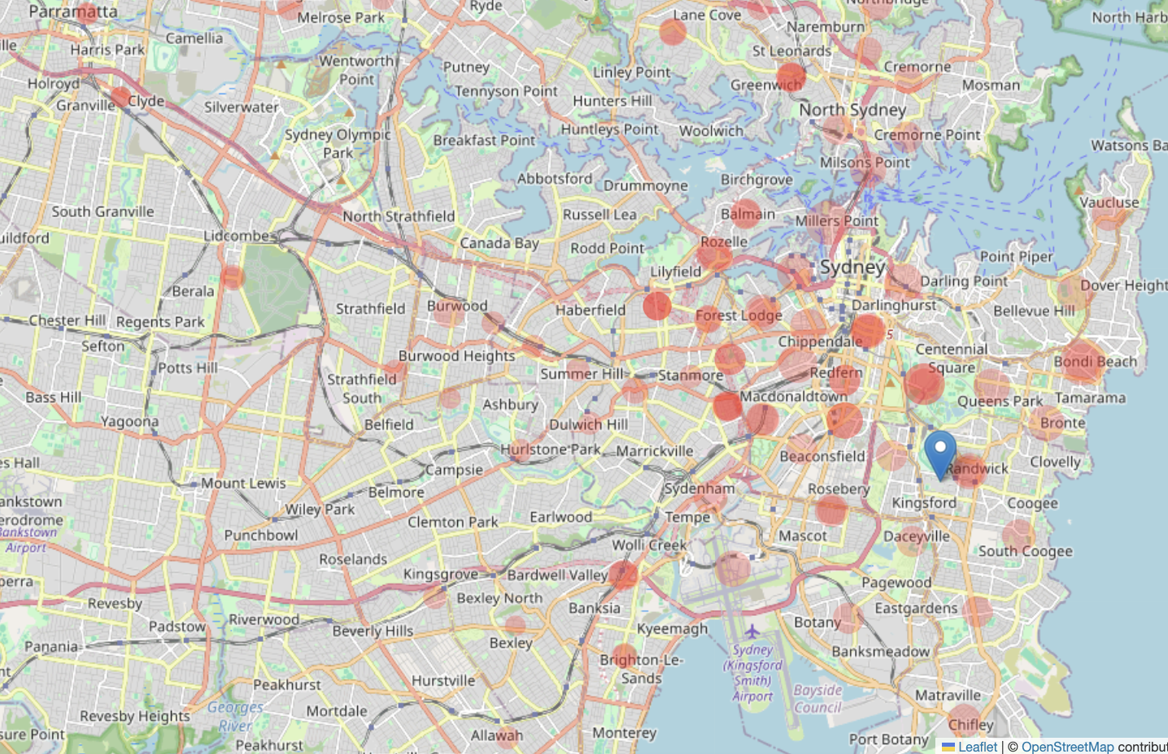
Map Of Rent Location By Price And Distance for 2 Bedrooms
Distribution of rent prices by distance in a map (Size of the bubble represents the price)

Slide 24
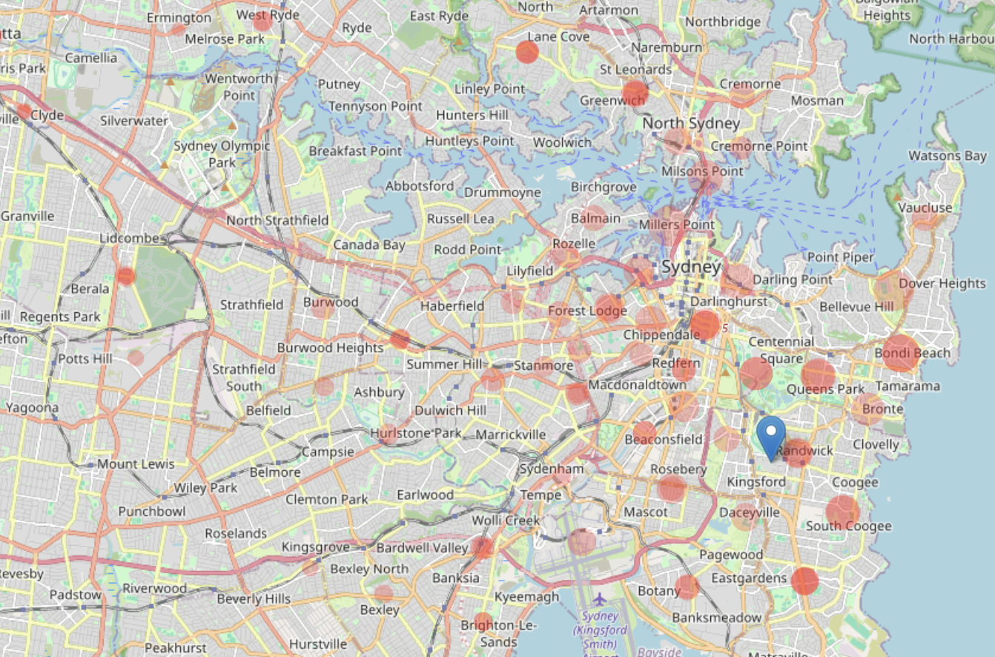
Map Of Rent Location By Price And Distance for 3 Bedrooms
Distribution of rent prices by distance in a map (Size of the bubble represents the price)

Slide 25
Quiz Time!
What is your top preference while choosing a place to stay ?
A) Affordability
B) Proximity
C) Access to amenities
D) Overall balanced factors

Slide 26
Recommendations
1
Low Budget:
For students where distance is not important, Parramatta and Strathfield are the most affordable places
2
Proximity:
If proximity is the top priority, Randwick, Waverly and Sydney are best options. One can save time and costs while commuting however the rent prices can be relatively on the higher end.
3
Easier Availability:
The most common types of dwelling are flat/unit and house, accounting for 47% for flats and 42% of the market is house. Three-bedroom dwellings are more available, even though four-bedroom apartments are more affordable.
4
Store Availability:
Sydney, Inner West, and Burwood the best availability of supermarkets and stores, making it convenient for shopping for groceries and other necessities. With Inner West the most affordable among all.
5
Balanced Criteria:
Rosebery, Newtown, Kingsford, Beaconsfield, and Zetland are the top suburbs for a combination of distance, affordability, transportation, and amenities.

Slide 27

GROUP 1
Conclusion
Sydney's growing rental crisis affect UNSW students to find the suitable rent, however with the help of data scrapping, statistical analysis, and data visualization with Python, the best accommodation choices for UNSW students can be concluded.

Slide 28
Appendix

Slide 29
Data Used
Variable | Source | Assumptions | Limitations
Rental Price, Rent Type, Price Stability | NSW Government (2023) | Use the latest data from Q4 2023. Preferred budget <500 AUD per week. | Fluctuations after Q4 2023 are not considered. Does not account for room-sharing situations.
Distance | Proctor, M. (n.d.) | Distance from/to UNSW calculated from the centroid of each LGA using longitude and latitude data. | Does not include precise locations within suburbs.
Transportation | Open Data Transport for NSW (n.d.) | Cost is based on the 'Distance' variable. Students commute to university three days a week using only public transportation. | Cover only three ranges of costs for different distances within Sydney and exclude students of not using public transport. It may oversimplify the assessment of weekly transportation expenses.
Store Availability | AreaSearch (n.d.) | A large supermarket is considered the main store needed for UNSW students. | Does not consider other types of stores. Does not consider the population in each LGA.
LGA Selection | University of New South Wales (2023) and Quick Survey to UNSW Students. | Parramatta, Strathfield, and Burwood are popular among UNSW students, in addition to seven accommodations listed on the UNSW website. | Potentially suitable accommodations in other areas may be overlooked.

Slide 30
References
AreaSearch (n.d.) Supermarkets [online]. Available at: https://areasearch.com.au/incolour/supermarkets [Accessed 4 March 2024].
NSW Government (2023) Average rental prices for the third quarter of 2023 [online]. Available at: https://www.facs.nsw.gov.au/download?file=854189 [Accessed 4 March 2024].
Open Data Transport for NSW (n.d.) Opal Fares [online]. Available at: https://opendata.transport.nsw.gov.au/dataset/opal-fares/resource/08722006-fcc6-4398-9549-b16f9529090f [Accessed 5 March 2024].
OpenAI (2023) ChatGPT: Optimizing Language Models for Dialogue [online]. Available at: https://www.openai.com/chatgpt [Accessed 10 April 2024].
Proctor, M. (n.d.) Full Australian Postcodes NSW [online]. Available at: https://www.matthewproctor.com/fullaustralianpostcodes_NSW [Accessed 6 March 2024].
PropTrack (2024) Rental affordability report 2024 [pdf]. Available at: https://www.proptrack.com.au/wp-content/uploads/2024/03/PropTrack-Rental-Affordability-Report-2024.pdf [Accessed 25 March 2024].
University of New South Wales (2023) Accommodation locations [online]. Available at: https://www.student.unsw.edu.au/accommodation/location [Accessed 25 March 2024].
OECD (2021) Housing Sector Country Snapshot: AUSTRALIA [pdf]. Available at: https://housingpolicytoolkit.oecd.org/www/CountryFiches/housing-policy-Australia.pdf [Accessed 10 April 2024].

